Slide 1
Math 4063 Case Studies in Mathematical Modeling
Using mathematical tools to explore real-world problems.
Instructor: Dr. Timothy Wu
Email: jingjinwu@uic.edu.cn
Office: T3-501-R6
TA: Mr. Alex Zhao
Email: alexyizhao@uic.edu.cn
Office: T3-502-R26

Slide 2
Text Book
A First Course in Mathematical Modeling (Fifth Edition)
Giordano, F.R., Fox, W.P., and Horton, S.B.
Cengage Learning, 2015
Reference Books
谢金星，姜启源等编《数学建模》
Readings
Various journal, conference, or WWW materials as appropriate.

Slide 3
General information
Assessment
Homework (10%)
Mid-term test Individual project (including “mini” projects) (20%)
Group project (20%)
Final Examination (50%)
Active participation in classes (up to 3% bonus)
Software
Matlab, Python, R, etc.
Pre-requisites
Calculus and computer programming

Slide 4
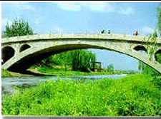
What is Mathematical Modeling?
Mathematical Modeling
Real Problem
Mathematical model
A mathematical model is a description of a system using
mathematical language.
The process of developing a mathematical model is termed
mathematical modeling (also written modeling).
Mathematical Modeling is an area of applied mathematics that uses
mathematical tools for exploring and studying "real world" problems.

Slide 5
Modeling: Applications
Has emerged as a powerful, indispensable tool for studying a variety of problems in scientific research, product and process development, and manufacturing.
Seismology
Climate modeling
Economics
Environment
Material research
Drug design
Manufacturing
Medicine
Biology
Analyze - Predict
Notes:
Seismology: oil exploration, earthquake prediction (Parallel computation reduced compute time from weeks to hours)
Global ocean/ climate modeling: global warming, weather prediction
Economics: growth of a local or national economy (Agent-based modeling), management of resources, analysis of tax strategies
Environmental: utilization of resources, population modeling, insect control
Materials research: design of new materials, smart materials; shape driven by temperature materials; materials aging issues (Stockpile stewardship)
Drug design: design of anti-cancer drugs, etc.
Manufacturing: optimization of manufacturing processes, automation
Medicine: Medical imaging, MRIs
Human genome: applications to understanding and treating disease

Slide 6
Example: Industry
First jetliner to be digitally designed, "pre-assembled" on computer, eliminating need for costly, full-scale mockup.
Computational modeling improved the quality of work and reduced changes, errors, and rework.

Slide 7
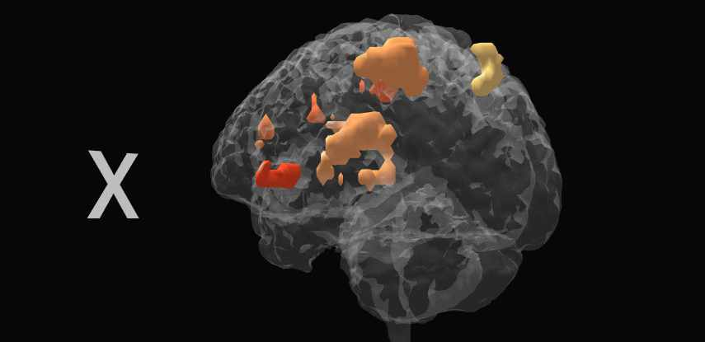
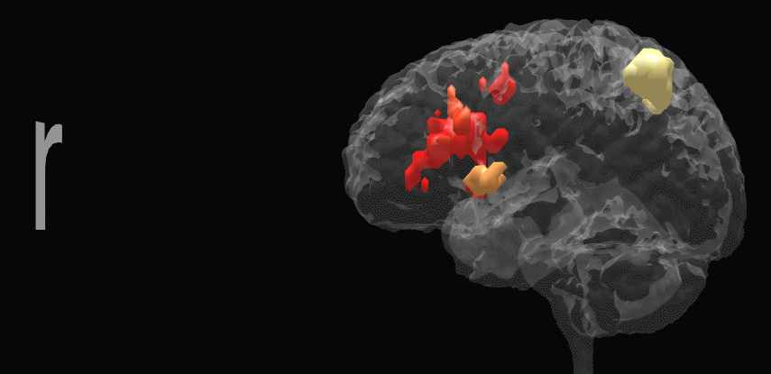
Example: Roadmaps of the Human Brain
Cortical regions activated as a subject remembers the letters x and r.
Real-time Magnetic Resonance Imaging (MRI) technology may soon be incorporated into dedicated hardware bundled with MRI scanners allowing the use of MRI in drug evaluation, psychiatry, & neurosurgical planning.

Slide 8
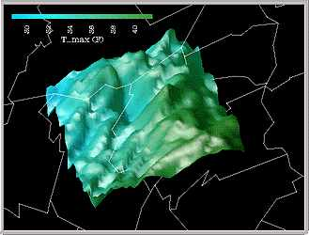
Example: Climate Modeling
3-D shaded relief representation of a portion of PA using color to show max daily temperatures.
Displaying multiple data sets at once helps users quickly explore and analyze their data.
Notes:
Other examples at this site:
Model of a red giant star
Protein folding problem
Impact of an astroid

Slide 9
Objective of this course
In this course, projects give students an opportunity to apply the principles of mathematical modeling creatively in various problem scenarios. While each project is related to the mathematical strategies that covered in class activities and lecture,
Students are expected to do some reading beyond the textbook and some library research to gain a solid background understanding of the problem scenario.
Students are expected to use appropriate technology as they study the problem, and to include the results of their investigations in a written report.

Slide 10
Mathematical Modeling Contest
Since 1985, each year in January/February, there is an international Mathematical Modeling Contest (MCM) and Interdisciplinary Modeling contest (ICM).
Now MCM/ICM has become one of the most famous international competition for college students.
The 2021 MCM/ICM were held on 5 to 9 January, 2021.
A secondary objective of this course is to assist students in developing skills to participate in modeling contests like this.

Slide 11
Mathematical Modeling Contest
After the competition, all papers are judged and placed into the following categories:
Unsuccessful Participant
Successful Participant
Honorable Mention (approximately 15% of teams)
Meritorious Winner (approximately 10% of teams)
Finalist (about 20-30 teams for each of ICM/MCM)
Outstanding Winner (less 20 teams for each of ICM/MCM)

Slide 12
MCM Statistics
Outstanding Winner 简称O奖，也就是特等奖 Finalist 简称F奖，是特等奖候补奖。 Meritorious Winner 简称M奖，也就是一等奖。 Honorable Mentions 简称H奖，也就是二等奖。 Successfully Participation 简称SP奖，成功参赛奖 。
2020年MCM共有13753支队伍参赛。(2019年：14108） 其中3852支队伍(28%)选择了A题，2455支队伍(18%)选择了B题，7446支队伍(54%)选择了C题。 获得O奖队伍数量：19 (0.001%) 获得F奖队伍数量：180 (~1%) (2019年之前约为0.002%） 获得M奖队伍数量：839 (6%) (2018年之前约为11%） 获得H奖队伍数量：3525 (26%) 获得S奖队伍数量：8956 (65%) 获得Unsuccessful participant/Disqualified队伍数量：233 （~1%）

Slide 13
ICM Statistics
Outstanding Winner 简称O奖，也就是特等奖 Finalist 简称F奖，是特等奖候补奖。 Meritorious Winner 简称M奖，也就是一等奖。 Honorable Mentions 简称H奖，也就是二等奖。 Successfully Participation 简称SP奖，成功参赛奖 。
2020年ICM共有7203支队伍参赛。（2019年:11262） 其中2089支队伍（29%）选择了D题，2527支队伍（35%）选择了E题，2586支队伍（36%）选择了F题。 获得O奖队伍数量：18 (0.002%) 获得F奖队伍数量：234 (3%) 获得M奖队伍数量：565 (8%) 获得H奖队伍数量：1567 (22%) 获得S奖队伍数量：4620 (64%) 获得Unsuccessful participant/Disqualified队伍数量：197（~2%）

Slide 14


Slide 15
2020 MCM Problem( A /B /C)Results
The 19 Outstanding Winners of MCM (A /B /C) Problem are:
Beijing Institute of Technology, China
Beijing Normal University, China (Frank Giordano Award)
Dongbei University of Finance and Economics, China (ASA Data Insights Award)
Harbin Institute of Technology, China AMS Award
NC School of Science and Mathematics, NC, USA (SIAM Award & MAA Award)
North University of China, China, (SIAM Award & AMS Award)
Northeast Electric Power University, China
Northwestern Polytechnical University, China
Shanghai Jiao Tong University, China (2)
Shenzhen University, China
South China University of Technology, China (AMS Award & COMAP Scholarship Award)
Southwest Jiaotong University, China
Southwestern University of Finance and Economics, China (INFORMS Award)
Tiangong University, China (Ben Fusaro Award)
University of Electronic Science and Technology of China, China University of International Business and Economics, China (INFORMS Award)
Wuhan University, China (INFORMS Award & COMAP Scholarship Award)
Xi'an Jiaotong University, China

Slide 16
History of CUMCM (中国大学生数学建模竞赛)
Since 1992, CUMCM (The Contemporary Undergraduate Mathematical Contest in Modeling) is an annual contest for undergraduates all over the world, organized by CSIAM (China Society for Industrial and Applied Mathematics), held in mid September each year.
Last CUMCM took place in September 2020, more than 45,000 teams (135,000 students) from 1470 institutions participated in the contest.

Slide 17
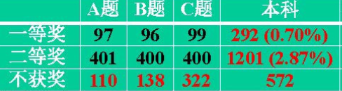
Statistics for CUMCM national award (2020)
国家一等奖: 292 (0.70%)
国家二等奖: 1201 (2.87%)
（国家奖按获奖个数控制）

Slide 18
Statistics for CUMCM Guangdong award (2018)
2018年广东省共有2272队参加本科组的比赛，其中
169组被评为省一等奖 （7.4%）
其中106组（4.7%）送评国家一等奖/二等奖
302组被评为省二等奖（13.3%）
472组被评为省三等奖（20.8%）
316组被评为优胜奖（13.9%）

Slide 19
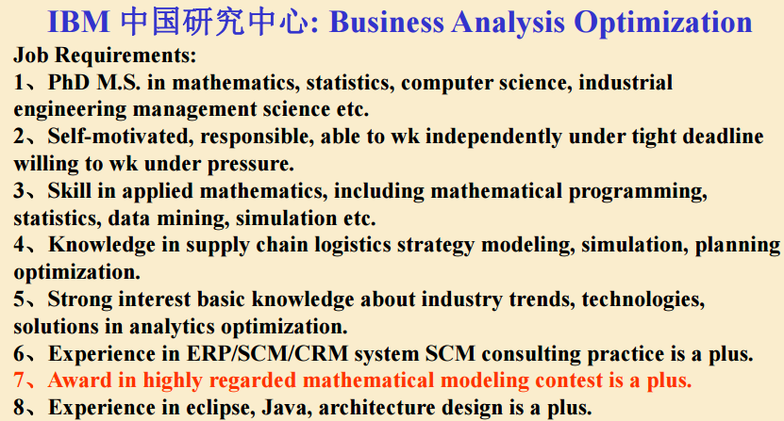
Benefits of winning the contests
--March 26, 2009, http://www.vyoung.com.cn/job/comp/jobinfo.asp?selectedid=1514

Slide 20
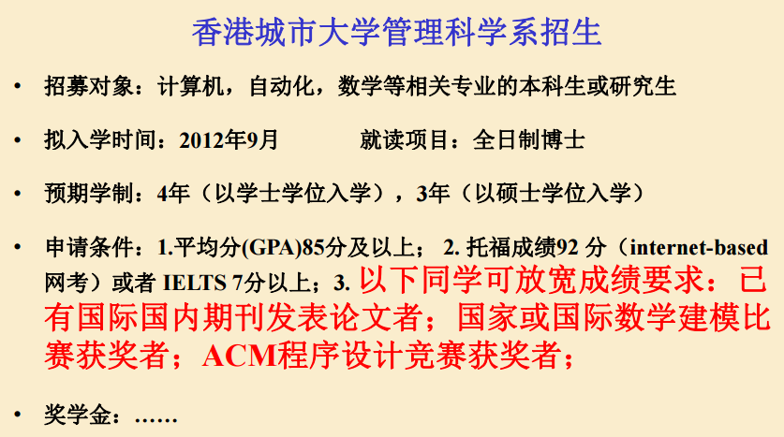
Benefits of winning the contests

Slide 21
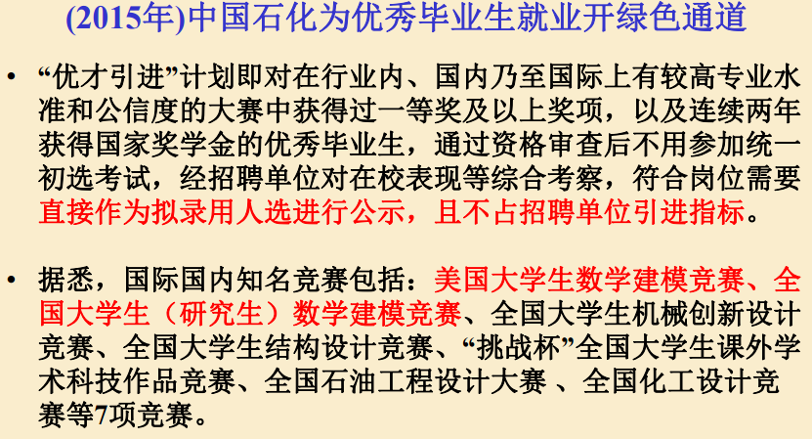
Benefits of winning the contests
http://www.sinopecgroup.com/group/xwzx/gsyw/20141008/news_20141008_349411402938.shtml

Slide 22
Online resources
国际数学模型网：http://www.mathmodels.org/
美国大学生数学建模竞赛: http://comap.com
中国大学生数学建模竞赛: http://mcm.edu.cn
中科大建模网: http://mcm.ustc.edu.cn/
国防科大: http://www.shumo.com

Slide 23
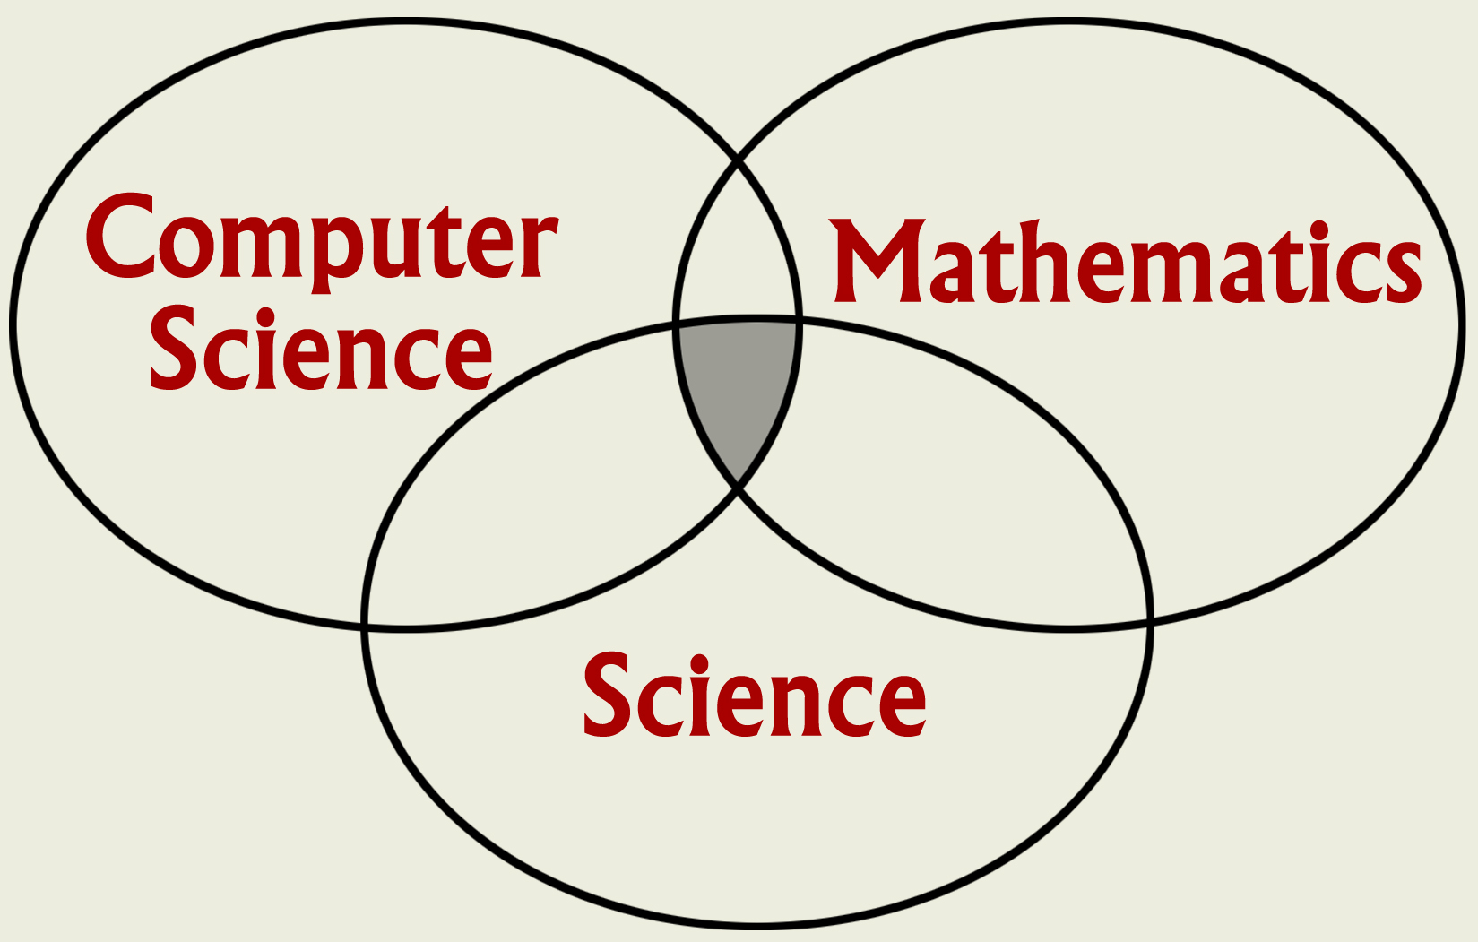
Mathematical modeling involves teamwork
Mathematical modeling seeks to gain an understanding of science through the use of mathematical models on computers.

Slide 24
What you will learn in the course?
Part 1: Overview and Basic Concepts
Chapter 1: Modeling Change
Chapter 2: The Modeling Process, Proportionality and Geometric Similarity
Chapter 3: Model Fitting
Part 2: Experimental Modeling
Chapter 4: Experimental Modeling
Chapter 5: Simulation Modeling
Part 3: Discrete Models
Chapter 6: Discrete Probabilistic Modeling
Chapter 7: Optimization of Discrete Models
Chapter 9: Decision Theory (subject to time constraint)
Chapter 10: Game Theory (subject to time constraint)

Slide 25
What you will learn in the course?
Part 4: Continuous Models
Chapter 11: Modeling with a Differential Equation
Chapter 12: Modeling with Systems of Differential Equations
Chapter 13: Optimization of Continuous Models
Part 5: Graph Theory Models
Chapter 8: Modeling Using Graph Theory
Let’s see some examples:

Slide 26
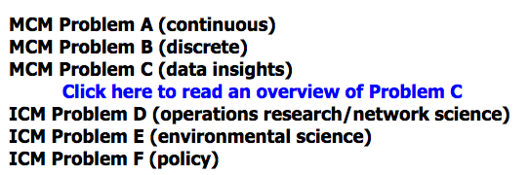

MCM/ICM 2021 Problems
Source: http://www.comap.com/undergraduate/contests/

Slide 27
Construction of Models
Step 1. Identify the problem.
Step 2. Make assumptions
(a) Classify the variables: primary factors,
(b) Determine the inter-relationships among variables.
Step 3. Solve or interpret the model.
Step 4. Verify the model
(a) Does the model answer the problem?
(b) Does it make common sense?
(c) Test it with real-world data.
Step 5. Implement the model.
Step 6. Maintain the model.

Slide 28
Example 1. Vehicular Stopping Distance (p.65, Chapter 2)
The following is from a driver education class.
Allow one car length for every 10 miles of speed under normal driving conditions, …. One way to accomplish this is to use the 2-second rule for measuring the correct following distance no matter what your speed. To obtain that distance, watch the vehicle ahead of you pass some definite point on the highway, like a tar strip or overpass shadow. Then count to yourself “one thousand and one, and one thousand and two;” that is 2 seconds. If you reach the mark before you finish saying those words, then you are following too close behind.

Slide 29
Problem identification:
Find the total stopping distance as a function of speed.
Assumption:
Total stopping distance
= reaction distance + braking distance
Main factors for reaction distance:
response time, speed, weather, system, etc.

Slide 30
So: reaction distance = f(response time, speed).
Main factors for braking distance:
weight, speed, brake, tires, road, etc.
So: braking distance = h(weight, speed).
Then, verify the model by comparing with real data.
All models have limitations. There are no “right” models, but only “suitable” models.

Slide 31

Example 2. Love Model (Differential equations)
Consider the following model:
dR/dt = aR + bJ
dJ/dt = cR + dJ
where
R is Romeo’s love for Juliet
J is Juliet’s love for Romeo
(or hate if negative)
a, b, c, d are constants that determine the ”Romantic styles”
Ref: sprott.physics.wisc.edu/lectures/love&hap/

Slide 32
Romantic styles
dR/dt = aR + bJ
a=0 (out of touch with own feelings)
b=0 (oblivious to other’s feelings)
a>0, b>0 (eager beaver)
a>0, b<0 (narcissistic nerd)
a<0, b>0 (cautious lover)
a<0, b<0 (hermit)
What are the assumptions/limitations of this model?

Slide 33
Example 3. Production Schedule (p.243, Chapter 7, Optimization)
Consider a carpenter who makes tables and bookcases. He realizes a net unit profit of $25 per table and $30 per bookcase. He has up to 690 board-feet of lumber and 120 hours of labor per week.
Suppose it requires 20 board-feet of lumber and 5 hr to complete a table and 30 board-feet of lumber and 4 hr for a bookcase.
What’s the weekly production schedule that maximize his profits?

Slide 34
Example 3. Production Schedule
Consider x as the number of tables and y as the number of bookcases. The optimization problem is
Maximize 25x + 30y (profit)
Subject to
20x+30y ≤ 690 (lumber)
5x+4y ≤ 120 (labor)
Will the optimal schedule change if the profits or available lumber/labor change?
We will come back to these examples later in the course.

Slide 35
The art of mathematical modeling
Model simplification
Restrict problem identification.
Neglect variables.
Conglomerate effects of several variables.
Set some variables to be constant.
Assume simple (linear) relationships.
Incorporate more assumptions.
Model refinement
Expand the problem.
Consider additional variables.
Consider each variable in detail.
Allow variation in the variables.
Consider nonlinear relationships.
Reduce the number of assumptions.

